Slide 1
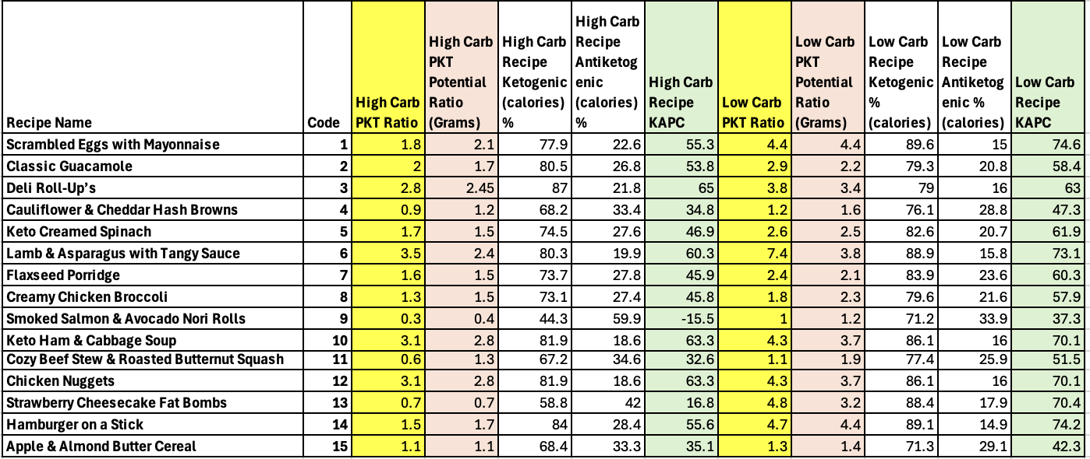
Ketogenic/Anti-ketogenic Potential of Food in Precision Medicine
Ankit Ambatipudi¹, Max Azzariti¹, Ashlin Cannella¹, Samantha Herrera¹, Mary Huang¹, Ashir Idrees¹, Miaohan Lin¹,
Vivek Panse¹, Heer Patel¹, Keya Patel¹, Saathviksai Reddy¹, Shreya Sreekanth¹, Shruti Sreekanth¹, Juliana Tu¹, Katherine Wiklund¹
Mentors: Parrish Winesett MD³, Maria Bruzzone MD⁴, Melissa L. Moreno MS², Zoe Craig², AnnMarie Muñecas², Hanyu Luo², Samantha Waterman², Peggy Borum² PhD
¹Students in ALS4932 ²FSHN at the University of Florida ³Division of Pediatric Neurology at the University of Florida ⁴Division of Adult Neurology at the University of Florida
Abstract
Figures
Methods
A century ago, use of ketogenic diet was introduced to the medical literature for the treatment of seizures. Since then, different versions used 1) grams of carbohydrate consumed per day, 2) a keto ratio of foods consumed per day (grams of dietary fat divided by the sum of grams of protein plus grams of carbohydrate), or 3) food with a low glycemic index. Medical literature supports use of the therapy for many chronic illnesses but concludes that the therapy must be defined in greater detail before the questions addressed can be answered for precision medicine.
We chose 20 recipes from a ketogenic website frequently recommended by medical providers, made a grocery list of foods listed in recipes, collected nutrient composition data for several products of each food that might be purchased by a patient, compared the nutrient content of the products for each food, and calculated several ketogenic and anti-ketogenic parameters for each recipe. We conclude that the product of the food chosen, and the parameter used for dosing are major controllable factors in the resulting therapy and should be documented. We are proposing the parameter Ketogenic/Antiketogenic Potential Percent (KAPC) as the next step in reaching a better-defined ketogenic therapy.
20 recipes were selected from the recommended website for ketogenic therapy, the Charlie Foundation.
15 CURE students created a database containing the nutrient composition of various products of foods listed in those recipes.
To compare different methods of ketogenic therapy dosing, we analyzed each product’s amount of carbohydrate, and the Modified Adkins high and low carbohydrate amounts, high and low PKT ratio, website (Charlie Foundation) keto ratio, and Ketogenic/Antiketogenic Potential of Calories for the 20 recipes.
Results
When considering the individual food products, we found that different brands of the same food have variable grams of carbohydrate per 100 grams. Analyzing products like mayonnaise, we were able to see the different brands per product vary between 0 to 13.3 grams of carbohydrate. Even among the same brand, certain variations of the product were found to be higher in carbohydrate than others. Consideration of the carbohydrate content is crucial to ketogenic therapy, and thus we used the highest and lowest carb examples for the purpose of our recipe creation and dosing method analysis.
When focusing on carbohydrate variation in recipe creation, it was seen that meals using brands of a food with lower carbohydrate content resulted in different doses of the Ketogenic Diet compared to the same food with higher carbohydrate. Both calculated results were often different from the grams of carbohydrate reported by the Charlie Foundation for the meal. A similar pattern was observed among the dosing of Precision Ketogenic Therapy, as meals using brands of a food with the lower carbohydrate content resulted in different dosing ratios compared to the high carbohydrate product. Both calculated results were often different from the Ketogenic Diet Ratio reported on the website for the meal.
Current dosing options assume that each gram of fat eaten is 100 precent ketogenic and each gram of protein and fat are 100 percent antiketogenic. However, empirical data have shown that 46% of protein is potentially ketogenic, and that 10% of fat is potentially antiketogenic (1). The Ketogenic/Antiketogenic Ratio (K/A ratio) and Ketogenic-Antiketogenic Potential of Calories (KAPC) dosing options incorporate this information.
Zilberter, T, et.al. Ketogenic Ratio Determines Metabolic Effects of Macronutrients and Prevents Interpretive Bias - Front Nutr 2018 Vol. 5 Article 75
Introduction
Currently, debate exists among patients and healthcare professionals regarding the best way to dose therapy. Current and proposed dosing approaches include:
Modified Atkins Diet (MAD) = an upper limit of grams of carbohydrate consumed per day
Ketogenic Diet (KD)– Keto Ratio = (grams fat) / (grams protein + grams net carbohydrate)
Precision Ketogenic Therapy (PKT) –PKT Ratio = (grams fat) / (grams protein + grams carbohydrate)
Proposed Ketogenic/Antiketogenic Ratio – K/A Ratio = ((0.9 grams fat) + (0.46 grams protein)) / ((1.0 gram carb) + (0.58 grams of protein) + (0.1 grams fat))
Proposed Ketogenic - Antiketogenic Potential of Calories (KAPC) = (((0.9grams fat * 9 Calories/gram) + (0.46 grams protein * 4 Calories/gram)) - ((1.0 grams carb * 4 Calories/gram) + (0.58 grams of protein * 4 Calories/gram) + (0.1 grams fat * 9 Calories/gram))
Families of patients often question whether the brand of a product matters for the purpose of preparing a recipe. We sought to answer this question as well as the primary question of healthcare providers regarding what the optimal method of dosing ketogenic therapy is.
Conclusion
Our analyses demonstrated the importance of brand specificity when utilizing ketogenic therapy. This data can be used to explain to families why they need to buy brand specific foods as listed in the personalized patient specific cookbook.
Healthcare providers can take advantage of computing power to use more specific calculations of dosing that was not available when ketogenic therapy was first created 100 years ago. Therefore, we suggest ketogenic programs utilize KAPC going forward.
The healthcare community and medical research community can benefit from better defined therapy that facilitates greater optimization for individual patients and facilitates reproducibility of ketogenic therapy research.

