Slide 1
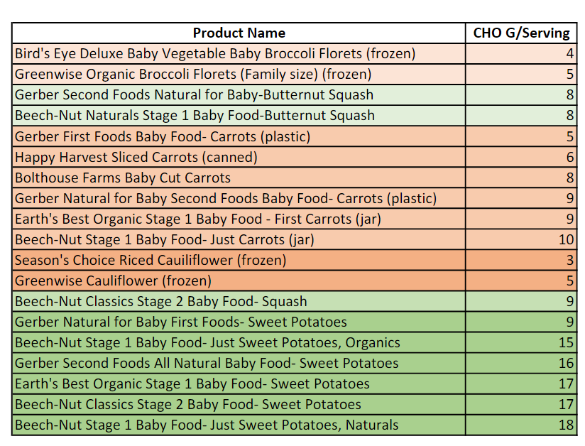
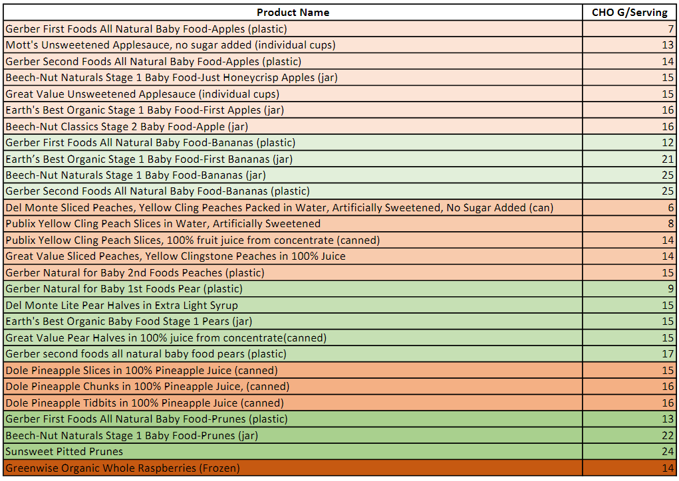
Nutrient Data Composition of Fruits and Vegetables
Practical Aspects of Using Food as Medicine to Reduce Seizures
RESULTS
Our results were consistent with those of the Spring 2022 CURE Class research team. At least 85% of products had a change in one of their macronutrients in the span of a year.
Carbohydrates per serving varied for both fruits and vegetables.
Different brands of the same fruits or vegetables had different amounts of carbohydrates.
DISCUSSION:
This variation in carbohydrates per serving requires families to search for specific products, some of which may not be readily available in all areas of Florida.
Using a different brand with a small difference in carbohydrates can reduce the efficacy of PKT.
There was variation in product availability. Products that could be found the previous year were discontinued or no longer sold.
NEXT STEPS:
Work with USDA to improve their Branded Foods database and include more foods in the Foundation Foods database.
Use the data from Food Runs and the Foundation Foods database to develop a profile template that can be applied to different brand products.
Obtain the nutrient composition of products that can be used for patients in intensive care units.
KEY TERMS:
Foundation Foods Database: A developing database managed by the USDA that includes nutrient fact information on raw foods.
Food Runs: Trips to local grocery stores to search for products that are used in patient recipes. Used to collect nutrient fact information on the products.
Branded Foods Database: A USDA database that contains the nutrient facts for brand-name foods as supplied by the manufacturer.
Precision Ketogenic Therapy (PKT): A food therapy that is specifically tailored to the patient's needs to induce nutritional ketosis and reduce seizures.
Authors: Kennedy Cook, Abigail Prettyman, Jordan Applebaum, Caitlyn Annunziato, Avery Branstetter
Mentors: Dr. Peggy Borum, Samantha Waterman
These two charts show the carbohydrates per serving for brand-name fruit and vegetable products. These products are used in recipes for patients on PKT. There is variation in the carbohydrate amount per serving among individual products in each group of fruits and vegetables.
BACKGROUND:
In the US, about 3.4 million people have epilepsy, which is about 1.2% of the population. Approximately 1/3 of patients with diagnosed epilepsy do not respond adequately to medications or surgery. The ketogenic diet was introduced in the 1920s to reduce seizures. Today, we are applying a Precision Medicine approach with our Precision Ketogenic Therapy program. Our Foodomics Database is the source of collected specific and detailed nutrient composition data for food available to patients.
METHODS:
Collected data on branded foods with Nutrient Fact Labels through Food Runs.
Searched for brand products used by patients in local grocery stores that are a part of the fruit and vegetable category.
Took six photos of different orientations of the product.
Entered and audited data from the photos into the Foodomics database.
Organized the collected data into two tables based on the fruit and vegetable type and carbohydrates per serving.

